Slide 1
CSC 362: System Programming
Lecture 6
Original slides by: Amitabha Dey
Adapted by: Dr. Richard Johnson
Department of Computer Science University of North Carolina at Greensboro

Slide 2

Status Check
Pointers and Strings in C
Dynamic Memory Allocation
Common Bugs
Null Bytes
Double Frees
Dangling Pointers
What we will cover today
malloc family of functions
malloc
calloc
realloc
free
Notes:
Covers the malloc family of functions: malloc, calloc, realloc, and free.
Topics include common bugs like double frees and dangling pointers.

Slide 3
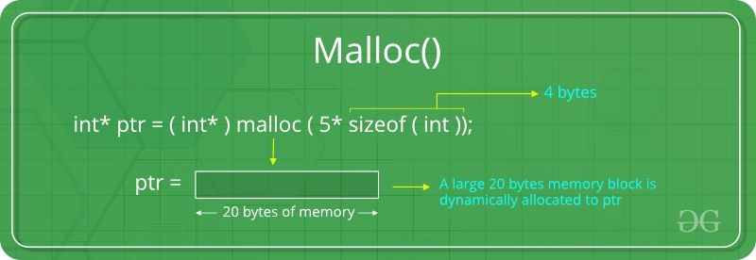

Understanding malloc
The malloc function in C is used for dynamic memory allocation. It allocates a specified number of bytes and returns a pointer to the allocated memory.
Internally, malloc interacts with the system’s memory manager, requesting memory from the heap and managing metadata to keep track of allocations.
Allocates a block of memory.
Returns a pointer to the beginning of the block.
Must be cast to appropriate pointer type.
Image credit - https://www.geeksforgeeks.org/
Image credit - Zihan @ Medium
Notes:
Understanding malloc
Used for dynamic memory allocation on the heap.
Allocates a specified number of bytes and returns a pointer to the start of the block.
The return value should be cast to the appropriate pointer type.

Slide 4
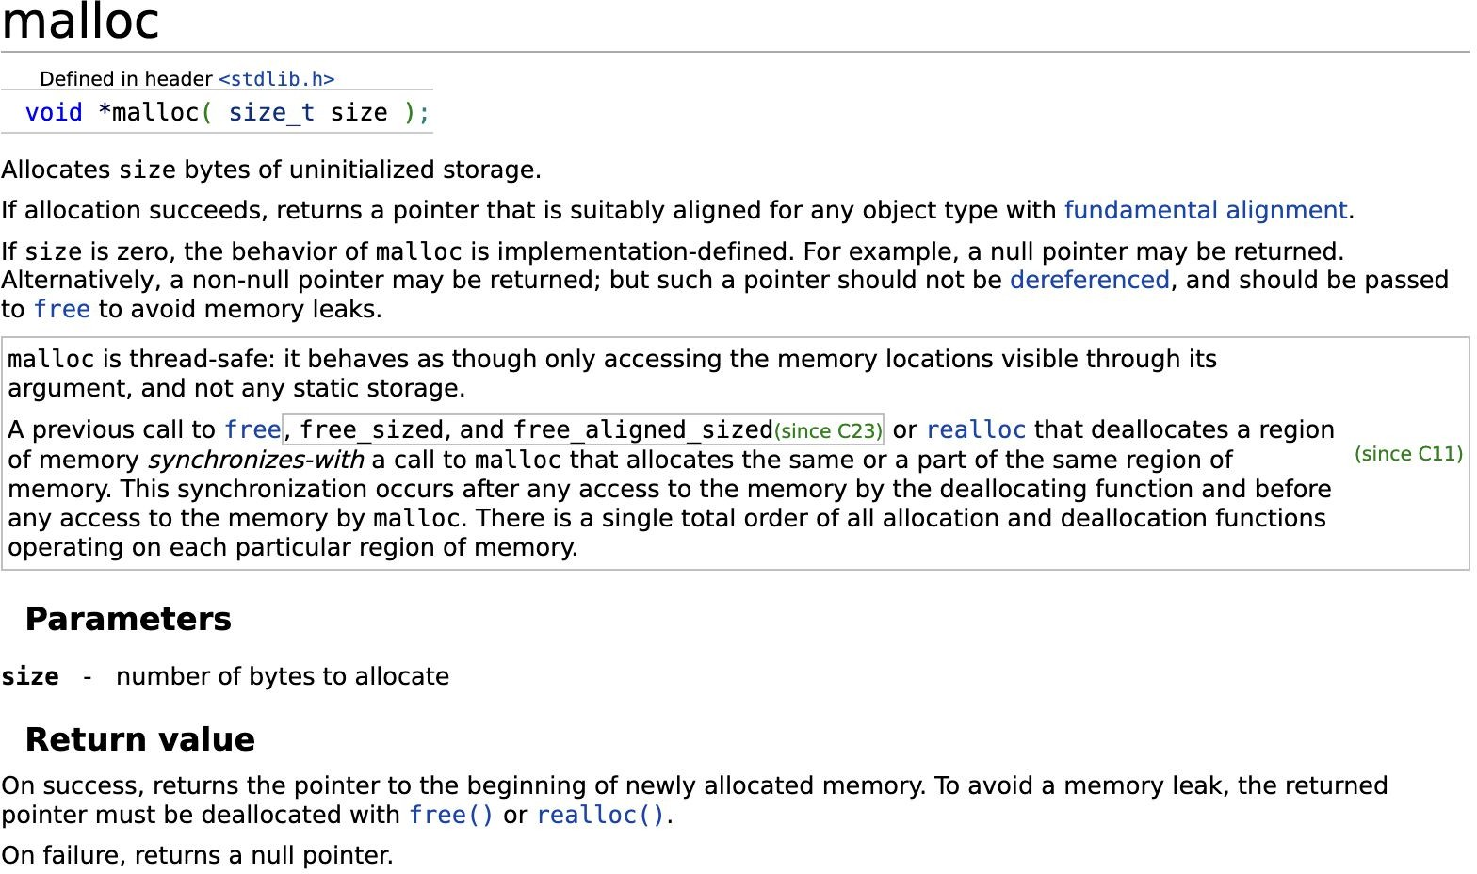
How malloc works?
Request Memory: It uses system calls like sbrk or mmap to request memory from the OS.
Manage Metadata: Keeps track of memory blocks (allocated and free) using structures such as linked lists.
Split and Coalesce Blocks: Efficiently manages free memory by splitting larger blocks or combining adjacent free blocks.
Notes:
How does malloc works?
Uses system calls like sbrk or mmap to request memory from the OS.
Manages memory via metadata (often using linked lists) to track free and allocated blocks.
Efficiently splits large blocks or combines (coalesces) adjacent free blocks.
For reference:
sbrk:
The sbrk system call is the traditional way to manage the heap.
It changes the location of the "program break,"
which is the address that marks the end of the process's data segment.
mmap:
The mmap system call creates a new mapping in the process's virtual address space.
It can map files directly into memory or create "anonymous" mappings (blocks of RAM not backed by a file).

Slide 5
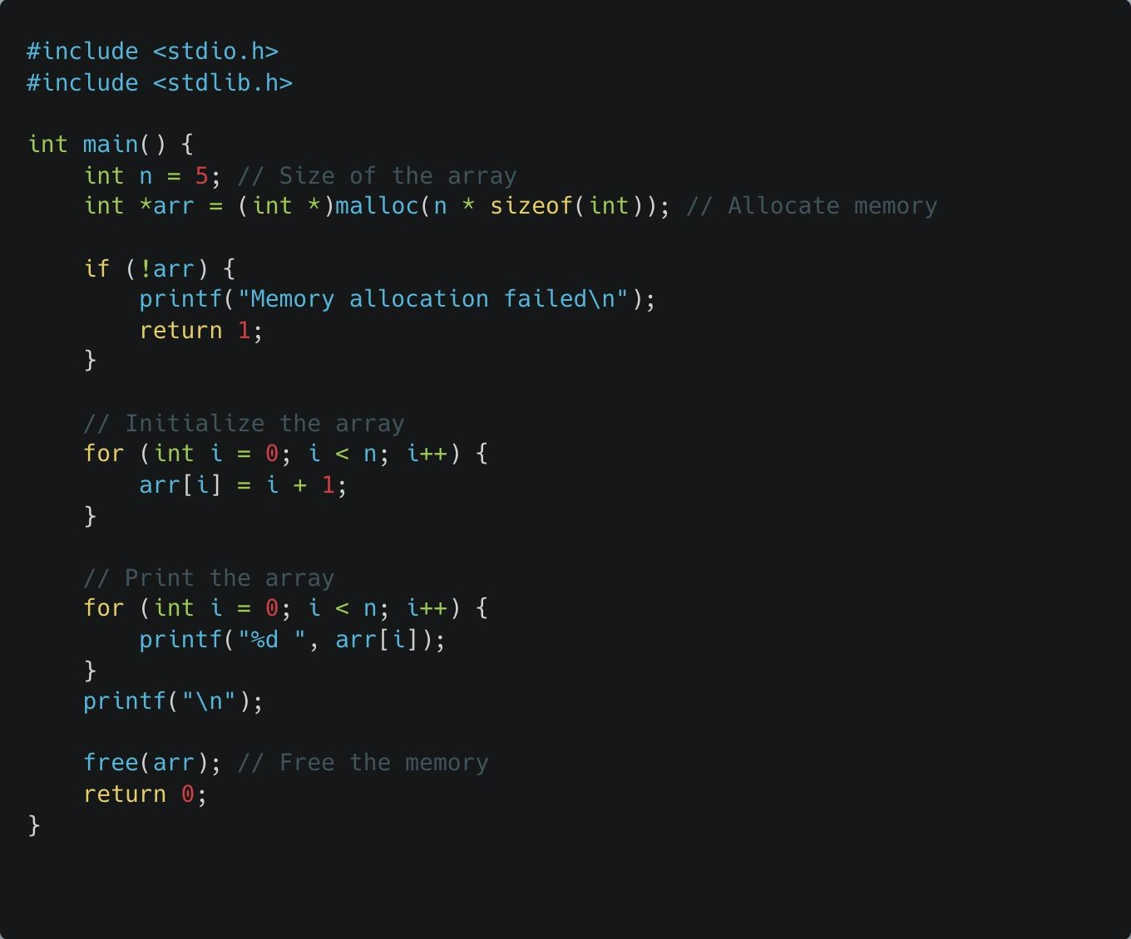
Code Example #1
What it does:
Allocates memory for an array of integers.
Initializes and prints the array.
Frees the memory after use.
Notes:
Code Example #1 (Introduction)
Demonstrates allocating an integer array, initializing it, printing it, and then freeing it.
See examples:
static_allocation.c dynamic_allocation.c

Slide 6
Code Example #1 Key difference
Key difference from true static allocation (like int arr[5];) is:
Memory from malloc is allocated on the heap, not the stack.
The size can be determined at runtime (e.g., user input for n).
You must manually free the allocated memory.
Notes:
Key Differences: Static vs. Dynamic
Dynamic memory is on the heap; Static is on the stack.
Size can be determined at runtime (e.g., based on user input), whereas static size is fixed at compile time.
Manual cleanup using free is mandatory for dynamic memory.

Slide 7
Code Example #1 Commands
Compile and Run the Program:
Find the process ID (PID) of your program:
Use vmmap for Detailed Memory Mapping
gcc -o malloc_test malloc_test.c
./malloc_test
ps aux | grep malloc_test
vmmap <PID>
Inspect Memory Usage in Real Time
Then, check its memory usage:
top -o rsize
ps -o pid,rss,vsz,command -p <PID>
This sorts processes by resident memory (physical RAM).
Look for your program
Check the MEM column.
RSS (Resident Set Size): Actual memory in RAM.
VSZ (Virtual Memory Size): Total allocated memory including swap.
Notes:
Compilation and Monitoring
Commands to run:
gcc -o malloc_test malloc_test.c.
Tools for real-time monitoring:
top -o rsize (resident memory) and
ps to check PID and memory usage (RSS vs VSZ).
For reference:
top:
MacOS: top -o rsize
Linux: top –o RES
Sorts processes by memory percentage (%MEM).
vmmap:
MacOS: vmmap
Linux: pmap
RSS (Resident Set Size)
This is the actual physical RAM the process is using at this exact moment.
VSZ (Virtual Memory Size)
This is the total address space the process has access to.
grep: (Global Regular Expression Print.)
It searches through files (or input piped from other commands)
for lines that match a specific pattern and prints those lines to your terminal.

Slide 8
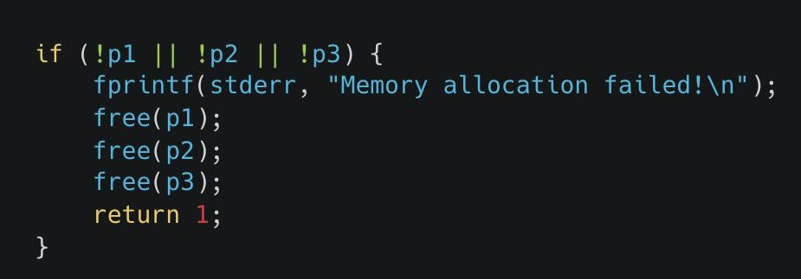
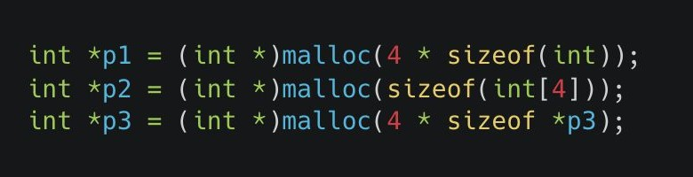
Code Example #2
We use malloc() to allocate memory dynamically.
malloc(size_in_bytes) → Allocates memory of the given size and returns a pointer to the allocated block.
We need memory for 4 integers, so we calculate memory size using sizeof(int).
(int *) is a typecast (optional in C, required in C++).
Why check malloc() return values?
If malloc() fails, it returns NULL, and accessing a NULL pointer leads to a crash.
How do we handle failure?
If any pointer is NULL, print an error message (fprintf(stderr, "Memory allocation failed!\n");).
free(p1); free(p2); free(p3); → Releases any allocated memory before exiting.
return 1; → Exits the program with an error code (1 indicates failure).
Notes:
Code Example #2 (Pointer Sizing)
Demonstrates different ways to calculate
malloc size: 4 * sizeof(int) or sizeof(int[4])
or the safer 4 * sizeof *pointer
Handling Allocation Failures:
If malloc fails, it returns NULL.
Accessing a NULL pointer will cause a crash.
Best practice:
Check for NULL and, if found, print an error to stderr,
free any previously allocated blocks and exit with an error code.
See example:
malloc_demo_1.c
malloc_demo_2.c (optional)
---
Long-form Description:
In C programming, the malloc function is used to allocate a specific number of bytes of uninitialized storage.
The code snippets you provided illustrate different ways to calculate that "size" parameter and how to handle the function's return value.
Allocation Methods
The first image shows three common ways to allocate space for 4 integers:
Method 1 (p1): Explicitly multiplies the number of elements by the size of the type: 4 * sizeof(int).
Method 2 (p2): Uses the size of an array type directly: sizeof(int[4]).
Method 3 (p3): Uses the size of the dereferenced pointer: 4 * sizeof *p3.
This is often considered the safest method because it automatically adjusts if the pointer's type is changed later.
Handling the Return Value
When you call malloc, it is crucial to verify if the operation succeeded:
Success: It returns a pointer to the beginning of the newly allocated memory.
Failure: It returns a null pointer.
The second image demonstrates robust error handling.
If any of the pointers (p1, p2, or p3) are null, the program prints an error message and terminates.
Importantly, it also calls free() on the pointers.
Passing a null pointer to free() is safe and does nothing,
while passing a valid pointer ensures that memory successfully allocated
before the failure is properly released to avoid memory leaks.

Slide 9
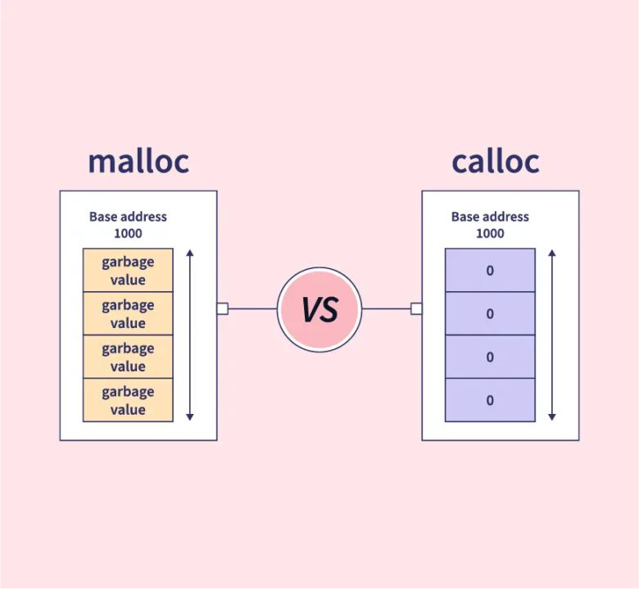

calloc (Contiguous Allocation)
Allocates memory and initializes all bits to zero.
Similar to malloc, but initializes the allocated memory.
Image credit - https://www.geeksforgeeks.org/
Image credit - Nasser El-Din Basha @ LinkedIn
Notes:
calloc Overview
calloc (Contiguous Allocation) allocates memory and automatically initializes all bits to zero.
Key Concepts:
While malloc provides uninitialized storage, these new images introduce calloc,
which serves a similar purpose with two distinct differences:
Initialization:
Unlike malloc, calloc initializes all bits of the allocated memory to zero.

Slide 10
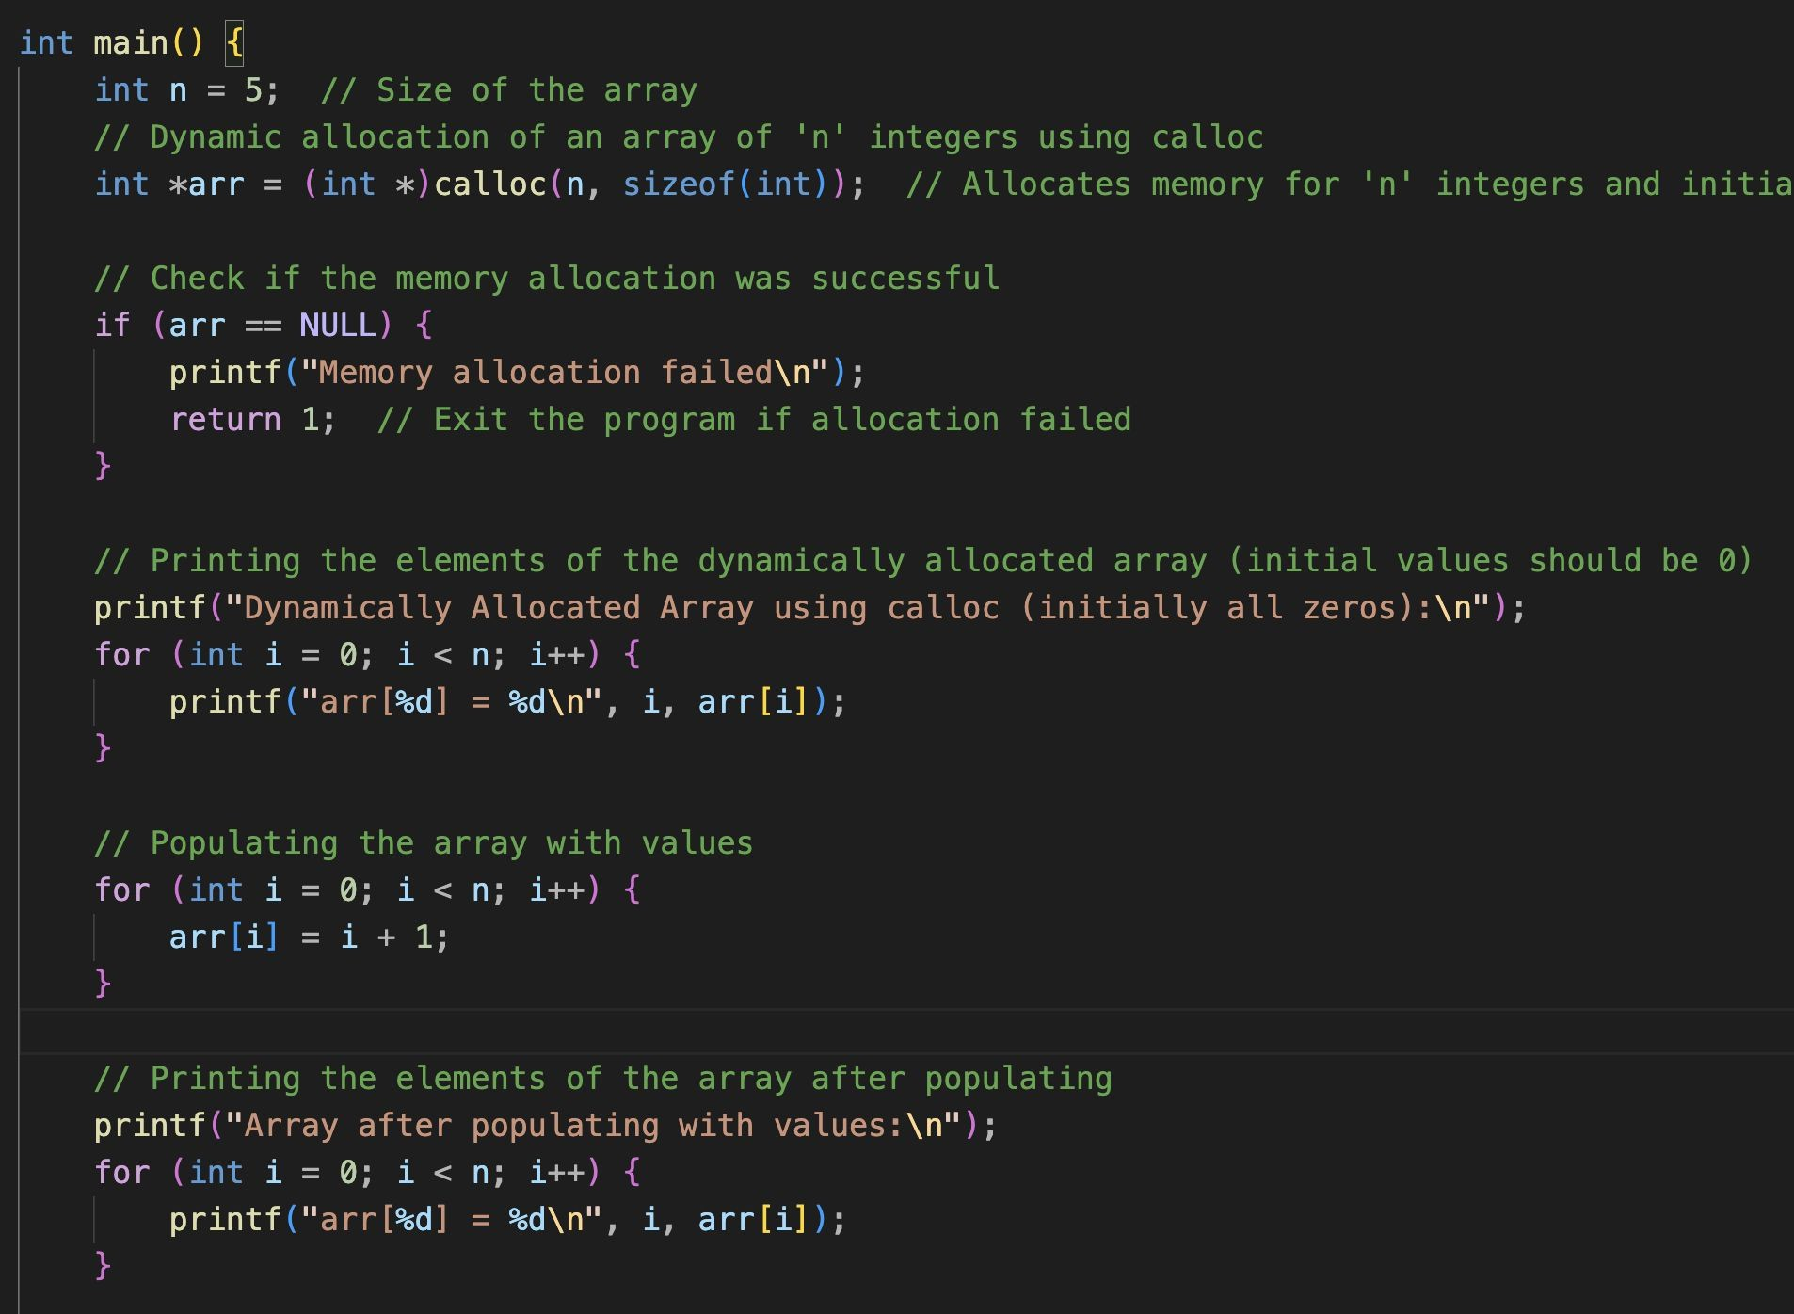
calloc (Contiguous Allocation)
calloc Function:
calloc is used to dynamically allocate memory for an array of n elements, where each element is of size sizeof(int).
The key difference between calloc and malloc is that calloc initializes the allocated memory to zero, whereas malloc leaves the memory uninitialized.
The calloc function takes two arguments: the number of elements (n) and the size of each element (sizeof(int)).
Memory Initialization:
Immediately after allocation, all elements of the array are set to 0. This is guaranteed by calloc, unlike malloc, where the content of the allocated memory is undefined until explicitly initialized.
Notes:
Difference Between malloc and calloc
calloc takes two arguments: number of elements and size per element.
malloc is faster but leaves memory uninitialized (undefined content).
Syntax:
It takes two arguments
the number of elements and the size of each element
rather than a single total byte count.
Proper memory management remains vital.
In all examples, the code checks if the returned pointer is NULL to handle potential allocation failures.
Furthermore, calling free() is essential to prevent memory leaks.
See example:
contiguous_allocation_1.c

Slide 11
calloc (Contiguous Allocation)
calloc Function:
calloc is used to dynamically allocate memory for an array of n elements, where each element is of size sizeof(int).
The key difference between calloc and malloc is that calloc initializes the allocated memory to zero, whereas malloc leaves the memory uninitialized.
The calloc function takes two arguments: the number of elements (n) and the size of each element (sizeof(int)).
Memory Initialization:
Immediately after allocation, all elements of the array are set to 0. This is guaranteed by calloc, unlike malloc, where the content of the allocated memory is undefined until explicitly initialized.
Use malloc: When you need to allocate memory quickly and don’t need it to be initialized.
Use calloc: When you need the allocated memory to be zero-initialized, typically for arrays or structures where default values should be zero.
Notes:
When to Use Which?
Use malloc for speed when initialization isn't needed.
Use calloc when you need an array or structure to start with default zero values.

Slide 12
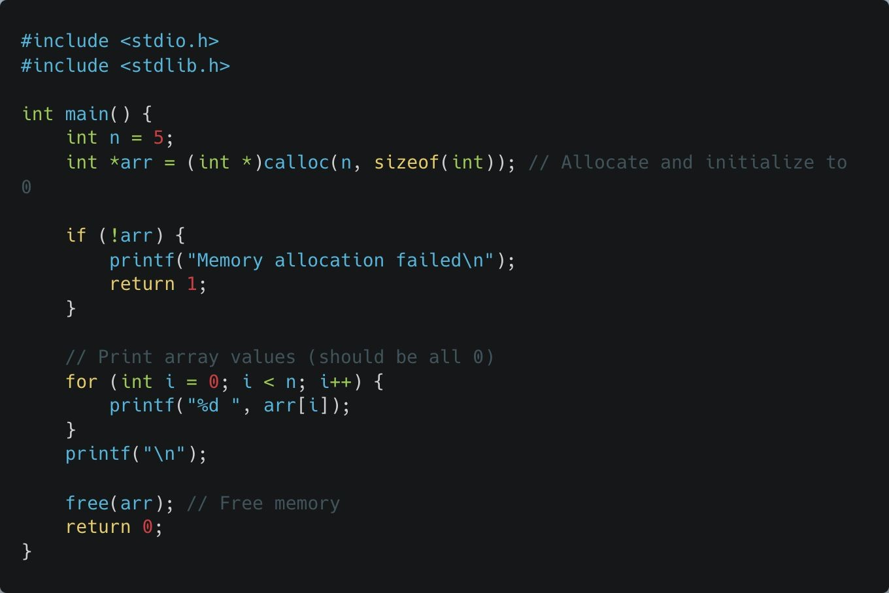
Code Example #3
calloc(n, sizeof(int)) allocates memory for n integers and initializes them to zero.
Unlike malloc, which leaves memory uninitialized, calloc ensures every byte is set to 0.
Notes:
Code Example #3 (calloc)
Code showing calloc(n, sizeof(int)) to ensure every byte is set to 0 from the start.
See example:
contiguous_allocation_2.c

Slide 13
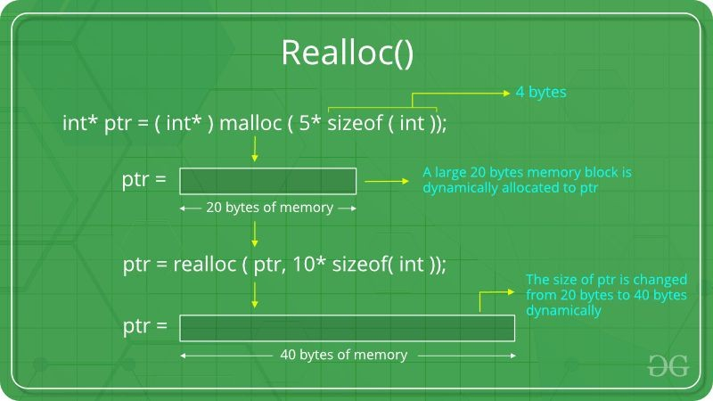
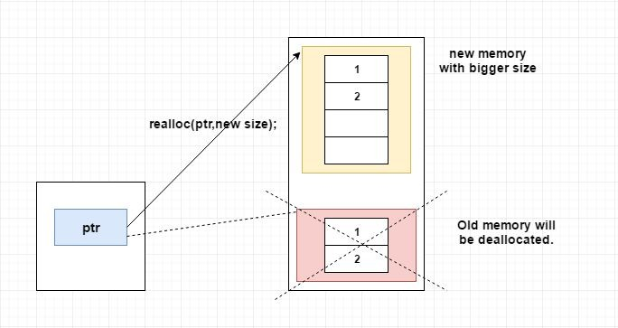
realloc (Reallocation)
Changes the size of an existing block of memory.
Useful for dynamically growing or shrinking data structures.
Image credit - https://www.geeksforgeeks.org/
Image credit - https://www.log2base2.com/
Notes:
Resizing with realloc
realloc Overview
Used to grow or shrink existing memory blocks.
Function:
realloc changes the size of a previously allocated memory block.
Expansion:
It allows you to increase the size of an array (e.g., from 5 to 10 integers) while attempting to preserve existing data.
Failure Handling:
Like malloc, it can return NULL if it cannot find a large enough contiguous block of memory.
The program must check for this to prevent crashes.

Slide 14
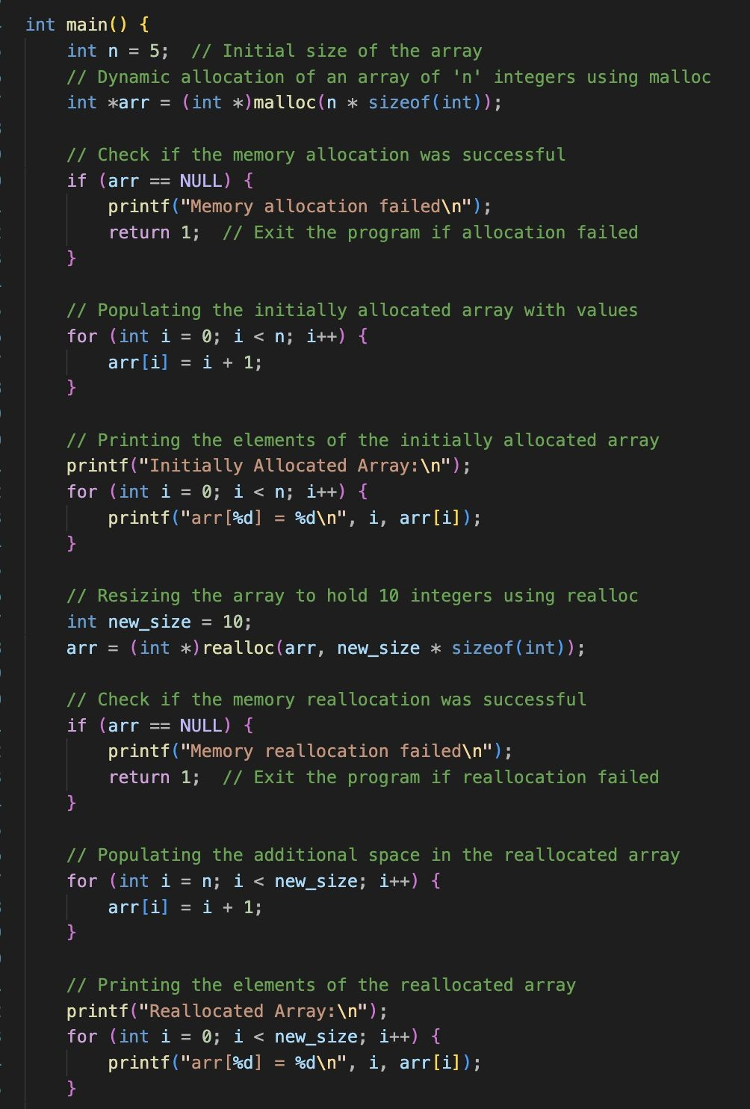
realloc (Reallocation)
Initial Allocation:
The program begins by allocating memory for an array of 5 integers using malloc.
It then populates this array with values 1 through 5.
Reallocation with realloc:
The array is resized using realloc to hold 10 integers.
The original content of the array is preserved, and additional memory is added to accommodate the new elements.
The additional elements (from index 5 to 9) are then populated with values.
Memory Management:
After resizing, the array is used normally, and finally, the memory is freed using free to avoid memory leaks.
Notes:
Reallocation Process
Code example showing an array resized from 5 integers to 10 integers.
See example:
reallocation.c

Slide 15
realloc (Reallocation)
Preservation of Data: realloc preserves the contents of the original memory block up to the smaller of the new and old sizes. This means that the ﬁrst 5 elements retain their values even after the array is resized.
Flexible Memory Usage: realloc is a powerful tool when you need to adjust the size of an array based on runtime requirements, allowing you to grow (or shrink) the array as needed.
Error Handling: It’s important to check the return value of realloc. If it returns NULL, the reallocation failed, and the original memory block remains allocated.
Notes:
Preservation of Data
realloc preserves existing data up to the size of the smaller block (new or old).
Error Handling for realloc
Crucial: If realloc returns NULL, the original block remains allocated and unchanged.
Always assign the result of realloc to a temporary pointer first to avoid losing the address of the original block if it fails.

Slide 16
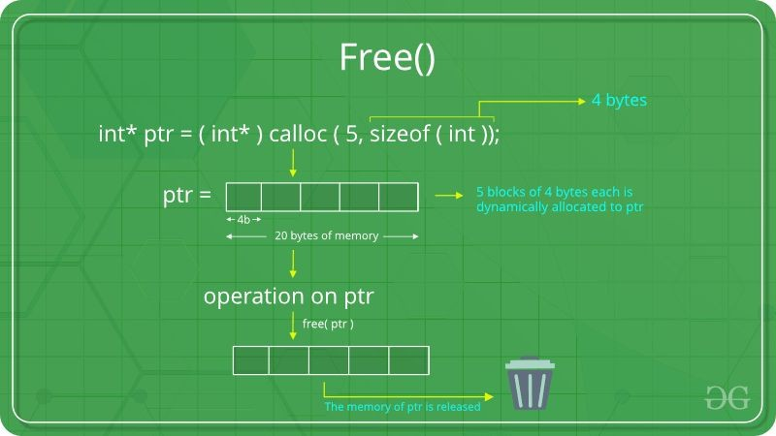
free (Memory Deallocation)
Frees memory previously allocated by malloc, calloc, or realloc.
Prevents memory leaks by returning memory to the system.
Notes:
free (Memory Deallocation)
Returns memory to the system to prevent exhaustion.

Slide 17
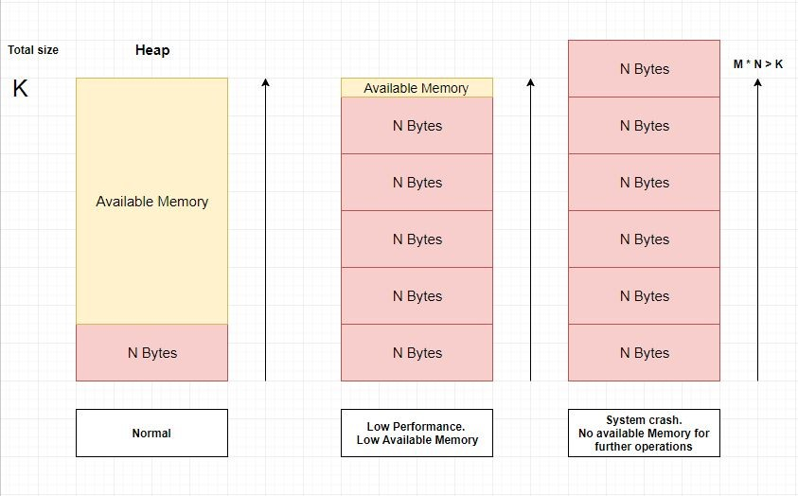
Memory Leaks
Occur when allocated memory is not freed.
Over time, can exhaust system memory, leading to crashes.
Important to always free memory when it is no longer needed.
Image credit - https://www.log2base2.com/C/pointer/free-in-c.html
Notes:
Understanding Memory Leaks
Leaks occur when memory is allocated but never freed.
Over time, these exhaust the heap and lead to system crashes.

Slide 18
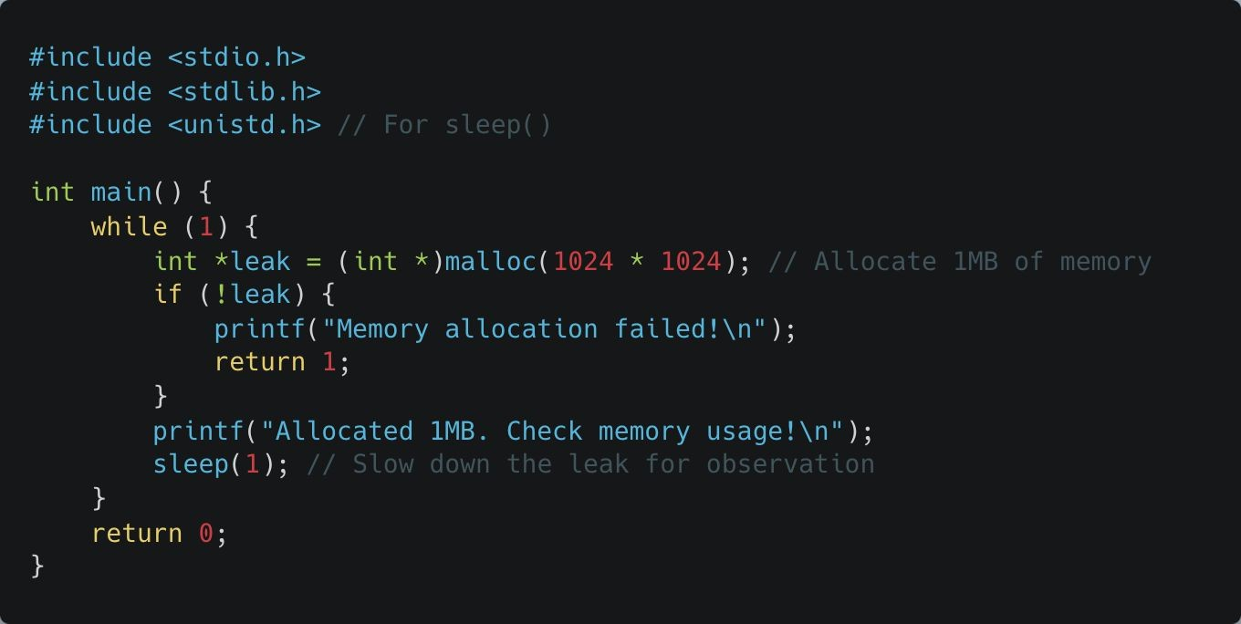
Memory Leaks
memleak.c
Compile and Run the Program:
gcc -o memleak memleak.c
./memleak
The program will keep allocating 1MB per second.
Notes:
memleak.c Example
A program that deliberately allocates 1MB per second without freeing it.
See example:
memleak.c
---
Long-form Description:
Understanding the Risks: Memory Leaks
While dynamic memory is powerful, failing to manage it correctly leads to serious issues.
The provided images highlight the progression from healthy memory usage to system failure:
The Cause:
A memory leak occurs when malloc or calloc is called inside a loop—as seen in the deliberate "leak" example—without a corresponding call to free(). This keeps memory marked as "in use" even when it is no longer accessible.
The Progression:
Normal: The heap has plenty of available memory for operations.
Low Performance: As leaked memory fills the heap, the system may slow down because it struggles to find contiguous blocks for new allocations.
System Crash: Eventually, the heap is exhausted ($M \times N > K$). Any further allocation attempts return NULL, and the program (or system) may crash if it doesn't handle the failure gracefully.
To prevent this, always ensure every allocation is eventually balanced by a free() call,
and always check your pointers for NULL to catch failures before they cause a crash.

Slide 19
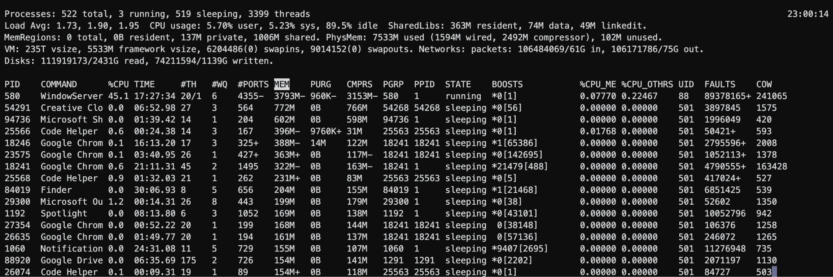
Memory Leaks
Use top to See Increasing Memory Usage: Open another terminal and run:
top -o mem
PhysMem keeps increasing!
Notes:
Detecting Leaks
Use top -o mem to see "PhysMem" (Physical Memory) constantly increasing.
MacOS: top –o mem
Linux: top –o RES

Slide 20
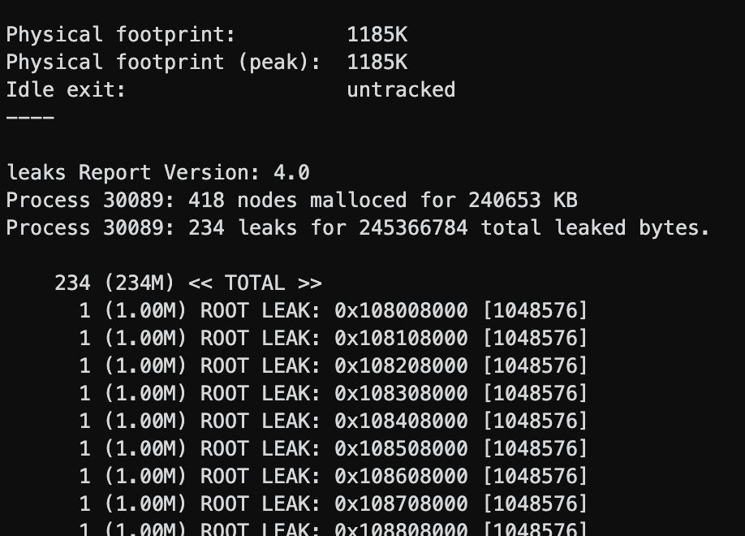
Memory Leaks
Use ps to Inspect Memory Usage:
Find your process ID (PID) with:
ps aux | grep memleak
Use leaks to Detect Memory Leak
leaks <PID>
Notes:
Detecting Leaks
The leaks <PID> command can be used to generate a detailed leak report identifying specific "ROOT LEAKS" and total leaked bytes.
See example:
mem_test.c

